Slide 1
Programming Fundamentals
CS118

Slide 2
Nida Munawar
Lecturer nida.munawar@nu.edu.pk
Room: (Lecturer Room opposite HR department, CS dept Basement )

Slide 3
Objectives of course
Getting acquainted with problem understanding, modeling and solving. Understanding the concept of Programming Languages. Two major areas to be covered: Computation and problem solving Implementation in C language. Design and implement algorithms to solve real world problems.

Slide 4
Course outline
Problem modeling, Basic Flowchart and block diagram, Algorithm analysis Data Types, Basic programming with algorithm Control structures: if-else, nested-if, switch case, Conditional Loops: For, While, do-while, Nested loop, Functions, Recursion, Introduction to Array(1- dimensional), Multiple subscripted arrays String Functions Introduction to Structures, structure array and pointer to structures File Processing File Processing(Binary and Text files), Introduction to Pointers, Pointers to array and double pointers. Dynamic Memory Allocation, Pointers functions and void pointers Revision(structures, Pointers, Arrays) Project evaluations

Slide 5
Text books
Name: C How to Program - 7th Edition Authors: Paul Deitel, Harvey Deitel Publisher: Pearson Name: Problem Solving and Program Design in C - 7th Edition Authors: Maureen Sprankle , Jim Hubbard Publisher: Prentice Hall
Reference books: Name: Working with C / Let us C Author(s): Yashwant Kanetkar Publisher: BPB Publications Name: Waite Group’s Turbo C - Programming for the PC Authors: Robert Lafore Publisher: SAMS

Slide 6
Marks Distribution
Class Performance: 5 marks
Quizzes: 10 marks
Assignment: 5 marks
Mid-term Exam-1: 10 marks
Mid-term Exam-2: 10 marks
Project: 10 marks
Final Examination: 50 marks
Throughout semester

Slide 7
Chapter 1
GENERAL PROBLEM SOLVING CONCEPTS

Slide 8
Overview
Problem Solving in Everyday Life
Types of Problems
Problem Solving with Computers
Difficulties with Problem Solving

Slide 9
Problem Solving in Everyday Life

Slide 10
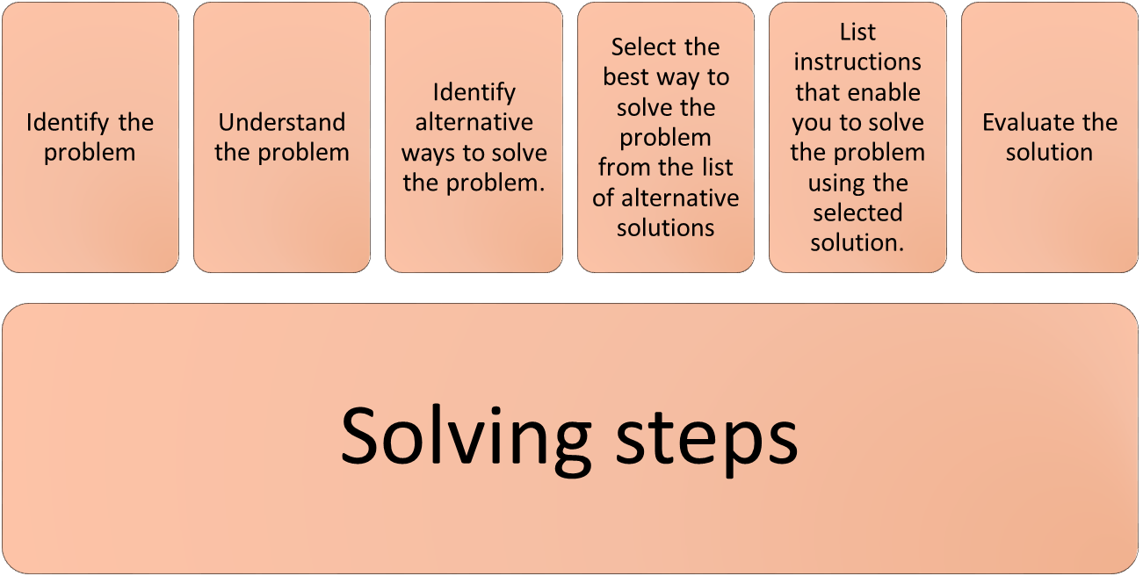
Six Steps of Problem Solving

Slide 11
Problem:
Consider the following problem:
“Going to work”

Slide 12

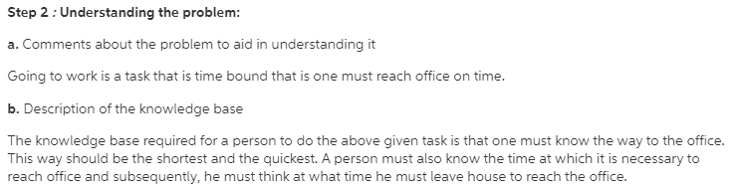
The problem is to go to work

Slide 13
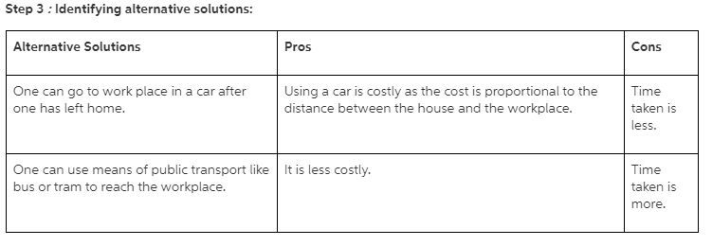

The problem is to go to work [Cont.]

Slide 14
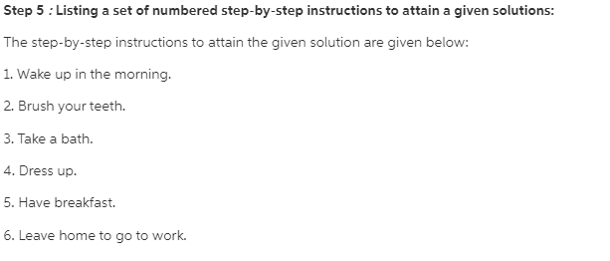

The problem is to go to work [Cont.]

Slide 15
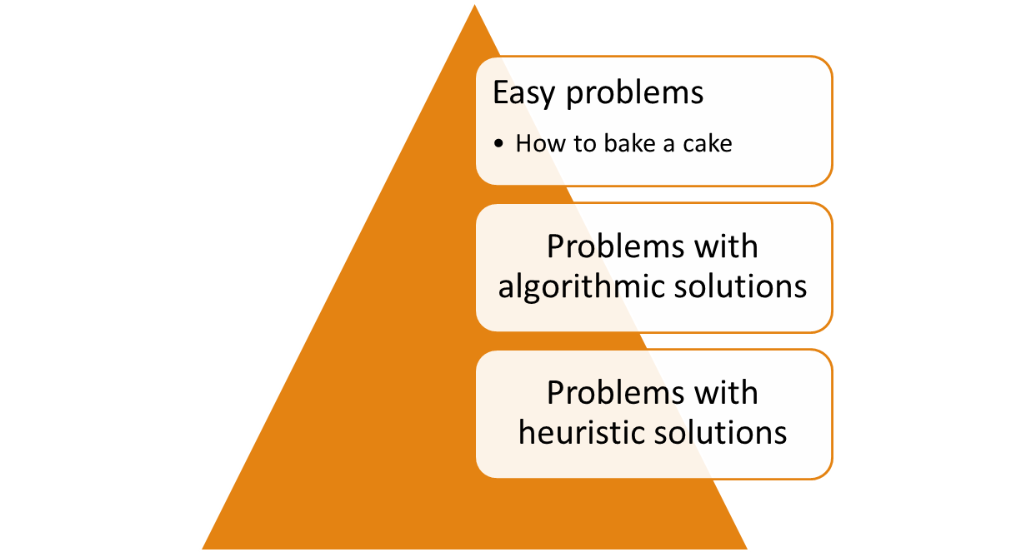
Types of problems

Slide 16
Problems with algorithmic solutions
  Can be solved in a number of steps e.g. balancing a
  check book.
  Algorithm: A number of steps that may be performed repeatedly to reach some solution

Slide 17
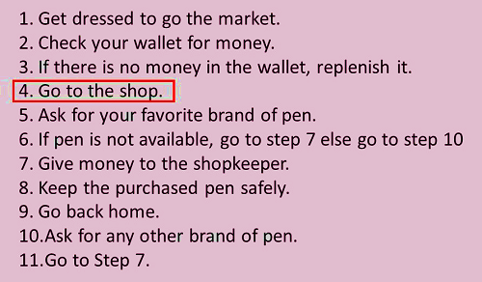
Algorithm for going to the market to purchase a pen
itself a complete task and separate algorithm can be written for it

Slide 18
Problems with heuristic solutions
  Solutions that cannot be reached through a direct set of steps are called heuristic solutions.
  These solutions require reasoning built on knowledge and experience, and a process of trial and error.
  Example: how to buy the best stock or whether to expand the company

Slide 19
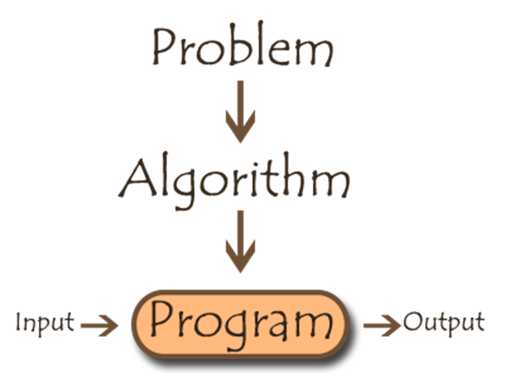
Problem solving with computers
Program means the set
of instructions that make up the solution after they have been coded into a particular
computer language.
Output/Results
means the outcome or the completed computer-assisted answer.

Slide 20
Computer Problem solving
Best for Algorithmic solution
  Calculating the monthly salary for employees
Not so good for Heuristic solution
E.g. the problem of how to throw a ball or how to speak
English
  Artificial intelligence enables a computer to do things like
  build its own knowledge bank and speak in a human language.

Slide 21
Difficulties in problem solving
The problem-solving process is not easy.
takes practice and time to perfect
Poor training
Afraid to make decisions
Incorrect problem definition
Inadequate steps of algorithm

Slide 22
Exercise:
Task of deciding which number is the largest from a group of three numbers
Almost anyone can immediately tell which is the largest, but many cannot explain the steps they followed to arrive at it.

